Slide 1
Criterion B & C
Practice Investigation Lesson 1

Slide 2
Recap: What is true for polygon
All polygons have curved sides. ➔ False (Polygons have only straight sides.)
A triangle is the simplest type of polygon. ➔ True
A circle is a type of polygon. ➔ False (A circle is not made of straight lines.)
A polygon must have at least three sides. ➔ True
A regular polygon has all sides and angles equal. ➔ True

Slide 3
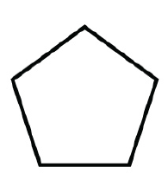
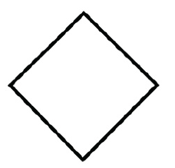
Recap: Diagonals

Slide 4
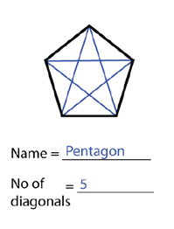
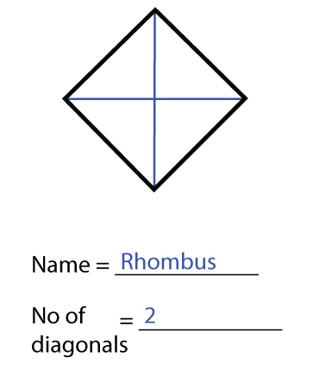
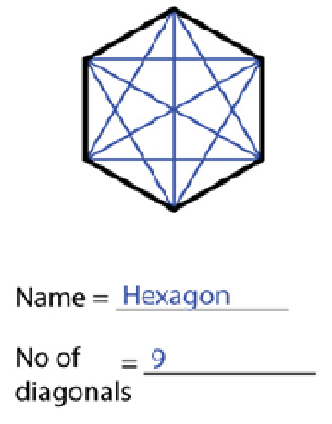
Recap: Diagonals

Slide 5
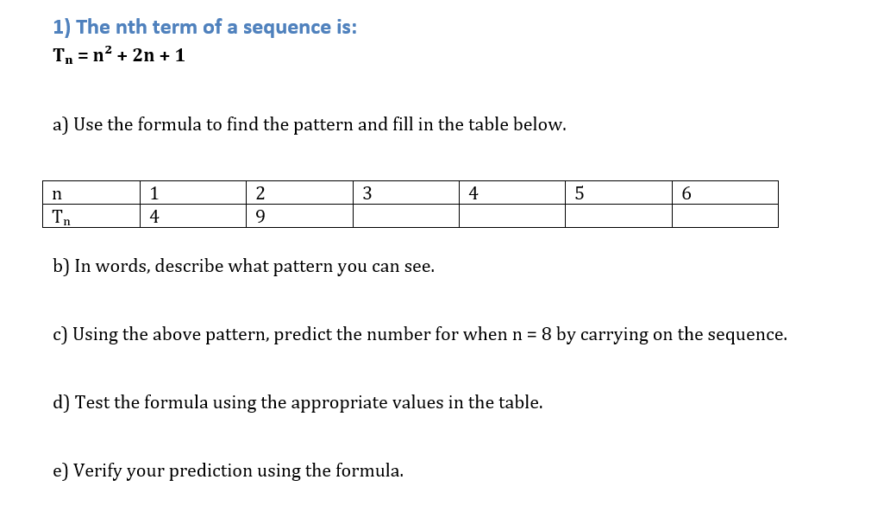
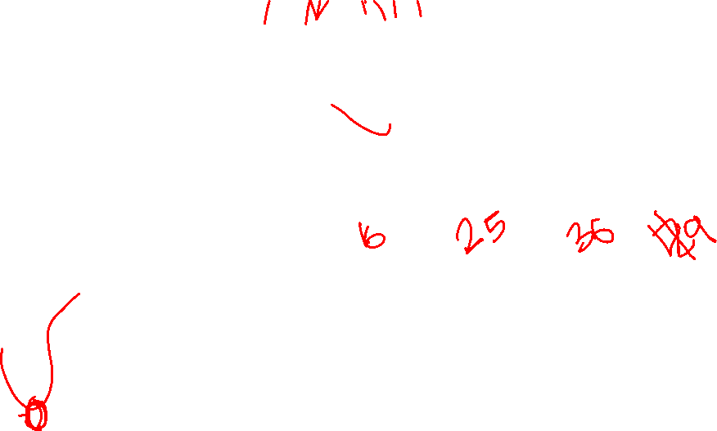
Example

Slide 6
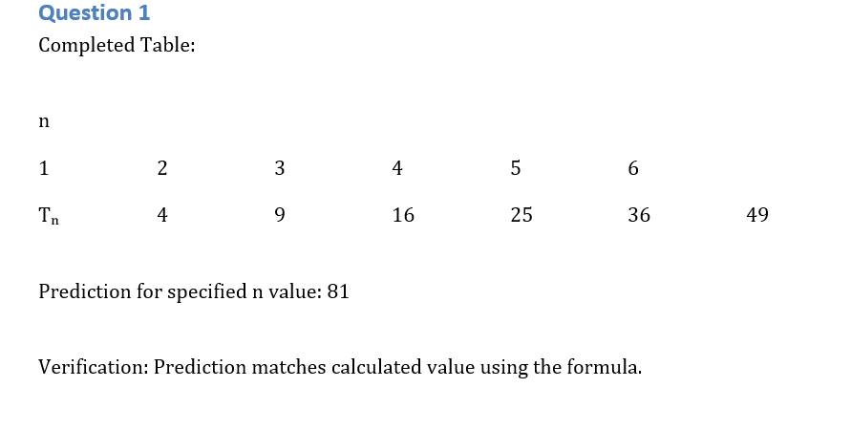

Slide 7
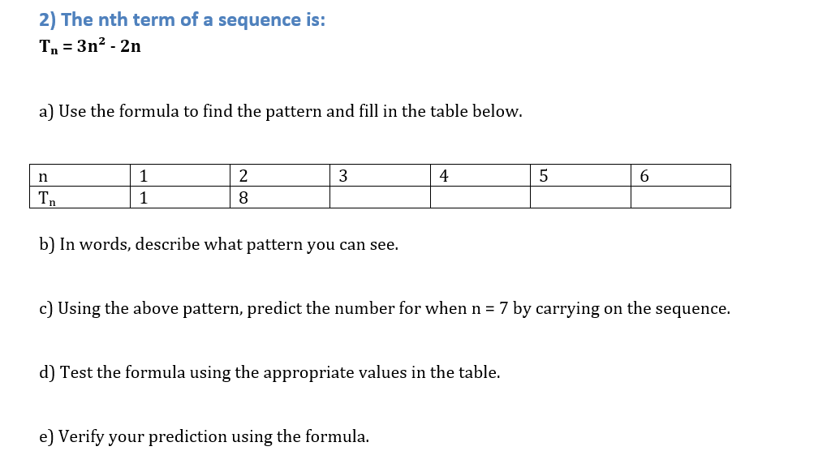
Assessment

Slide 8
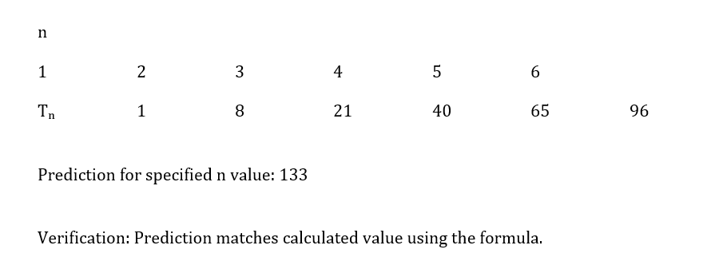

Slide 9
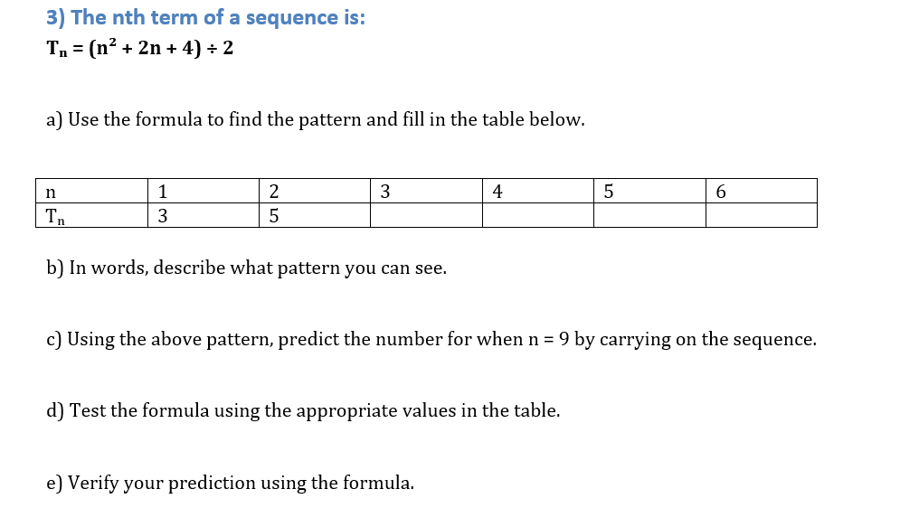
Your Turn

Slide 10
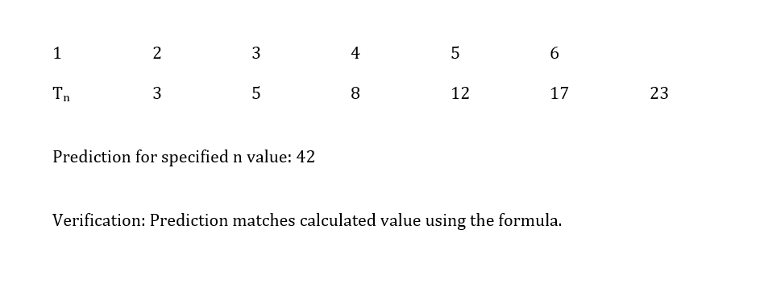

Slide 11

1) Record your results in the table:
Pattern number | Number of footballs
1
2
3
4
1
3
6
10
2) In words, describe what pattern you can see in the number of footballs.
Pattern is increasing by adding the pattern number for example 1 is 1 2 is 1+2=3…

Slide 12
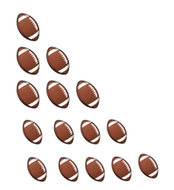

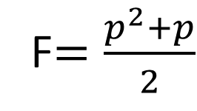
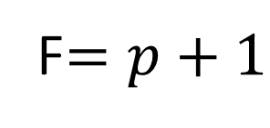
3) Using your pattern, predict how many footballs will be in the 5th pattern.
4) Prove your prediction is correct by drawing the 5th pattern.
5) If we use the letter P to be the pattern number, and F to be the number of footballs, determine which formula is correct:
5th pattern → 15 footballs
F$=\frac{p^{2}+p}{2}$
F$=\frac{p+1}{2}$
F$=p+1$

Slide 13
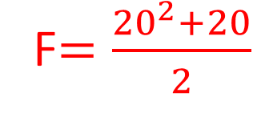



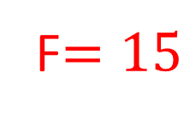
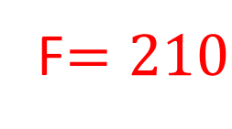

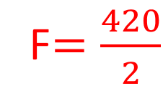

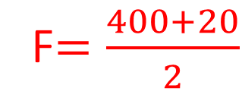
6) You must clearly explain your reasoning with more than one example.
F$=\frac{p^{2}+p}{2}$
Pattern 20
F$=\frac{p^{2}+p}{2}$
F$=\frac{5^{2}+5}{2}$
F$=\frac{{20}^{2}+20}{2}$
F$=\frac{25+5}{2}$
F$=\frac{400+20}{2}$
F$=\frac{30}{2}$
F$=\frac{420}{2}$
F$=15$
F$=210$

Slide 14
Criterion B & C
Practice Investigation Lesson 2

Slide 15
Acer Starter 2
Identify the 3D Shape Look at the descriptions below and write the correct name of the 3D shape.
A shape with 6 faces, all of which are squares. ______________
A shape with 1 curved surface and 2 circular faces. ______________
A shape with only 1 face and comes to a single point. ______________
Cube
Cylinder
Cone

Slide 16
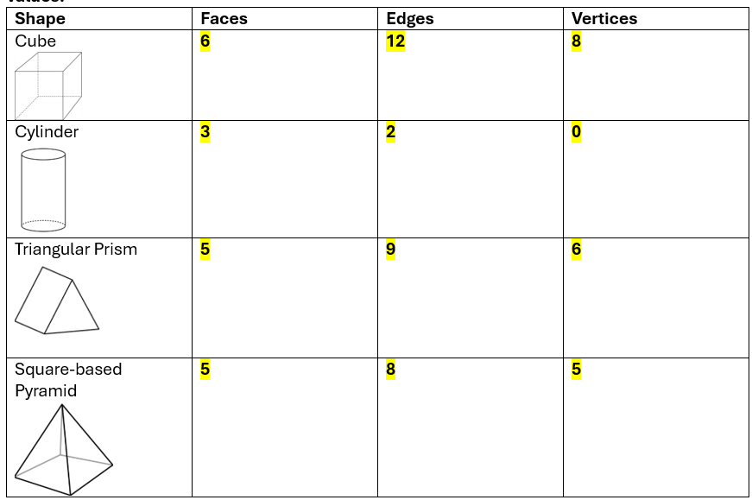
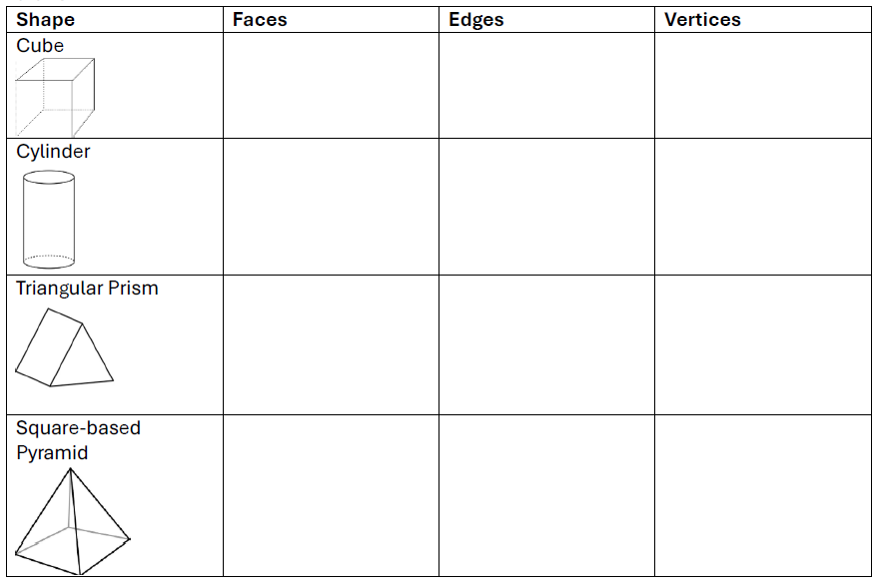
Count the Faces, Edges, and Vertices Complete the table below by filling in the missing values:
True or False? Circle the correct answer.
A sphere has no edges or vertices. True / False
A triangular prism has 5 faces. True / False
A cone has a curved surface and a circular face. True / False

Slide 17
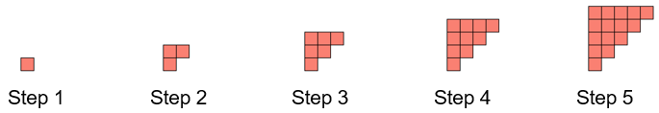
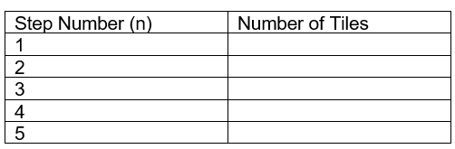
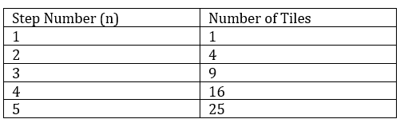
Investigation: Building Steps with Square Tiles
Fill in the table below:
1. In words describe what pattern you can see in the Number of tiles
2. The sequence of numbers is a well-known set of numbers. What is the nth term?
3. Use this rule to calculate the number of tiles in step 10.
Step 10 would use 10² = 100 tiles
4. Verify that this rule is correct.
Can carry on the sequence :
25 + 11 = 36
36 + 13 = 49
49 + 15 = 64
64 + 17 = 81
81 + 19 = 100- this is the same answer found when using the formula
5. If you have 225 tiles, how many steps can you build?
15
With 225 tiles, you can build 15 steps since
15² = 225.
The difference in the number of tiles is increasing by two, as the step number increases by 1/ the second difference is two . This means it is a quadratic sequence.
T= n²

Slide 18
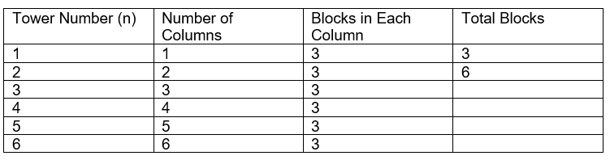
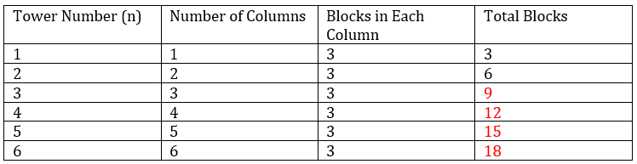
Building Block Towers
Layla is building towers out of blocks for a school art project. She notices some interesting patterns as her towers grow. Let’s help her figure out how many blocks she needs!
Question
Complete the table.
Describe the pattern in the total number of blocks.
3. Can you write a formula for the total number of blocks in Tower n?
Part A: Straight Towers
Layla builds a tower using the same 3-blocks-high column each time. - Tower 1 has 1 column, and each column uses 3 blocks. - Tower 2 has 2 columns. - Tower 3 has 3 columns. - And so on…
The total number of blocks increases by 3 as the tower number increases by 1. This means it is a linear sequence.
B = 3n
4. How many blocks will Layla need for Tower 15?
B = 3 x 15= 45

Slide 19
5. Test and verify the formula you have found to check that it is correct.
Test :
n=1
B = 3 x 1= 3
n=2
B = 3 x 2 = 6
These are the same as the values seen in the table
Verify
Carry on sequence:
18 + 3 = 21
21 + 3 = 24
n=7
B= 3 x 7 = 21
n=8
B= 3 x 8 = 24
These are the same as the values found when continuing the sequence
Tower 15: 3 × 15 = 45 blocks

Slide 20
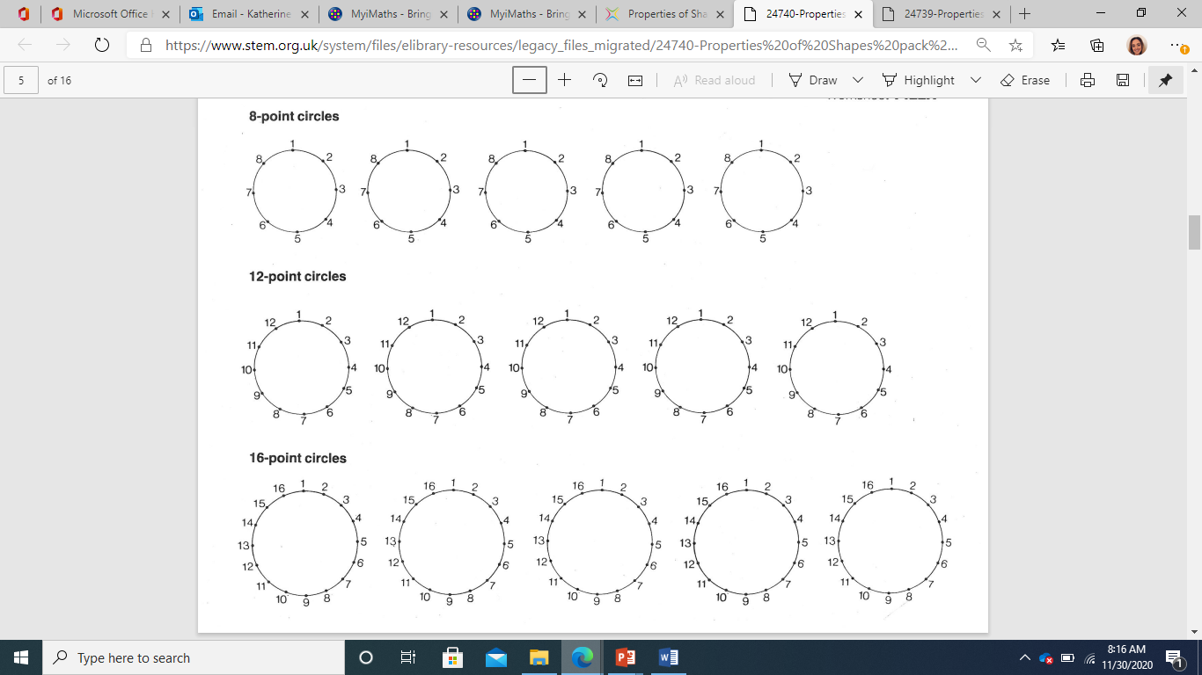
Try to join the points to create a rectangle
How many different rectangles can we create?

Slide 21
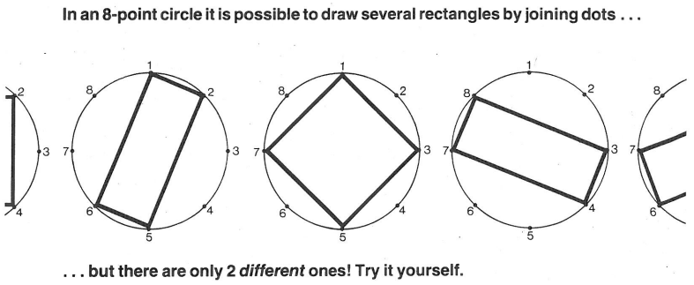

Slide 22
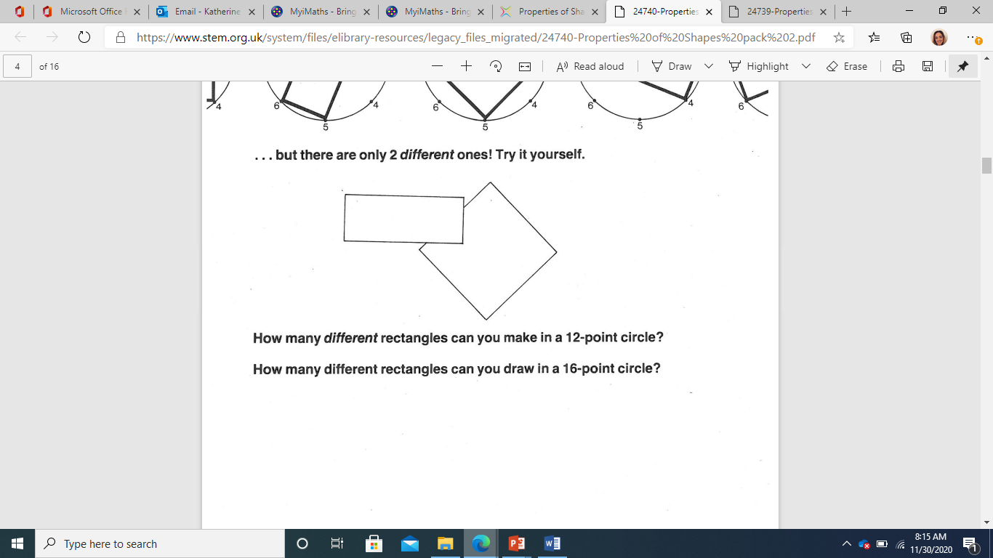

Slide 23
How many rectangles are there?

Slide 25
What is the pattern?
Every time we increase the number of points by four, we can create another rectangle.

Slide 26
What is the rule?
If you divide the number of points by 4, you can find the number of rectangles.
R = P/4

Slide 27
Test & Verify
To test our rule, we need to check that the values work and compare them to the patterns we have been given.

Slide 28
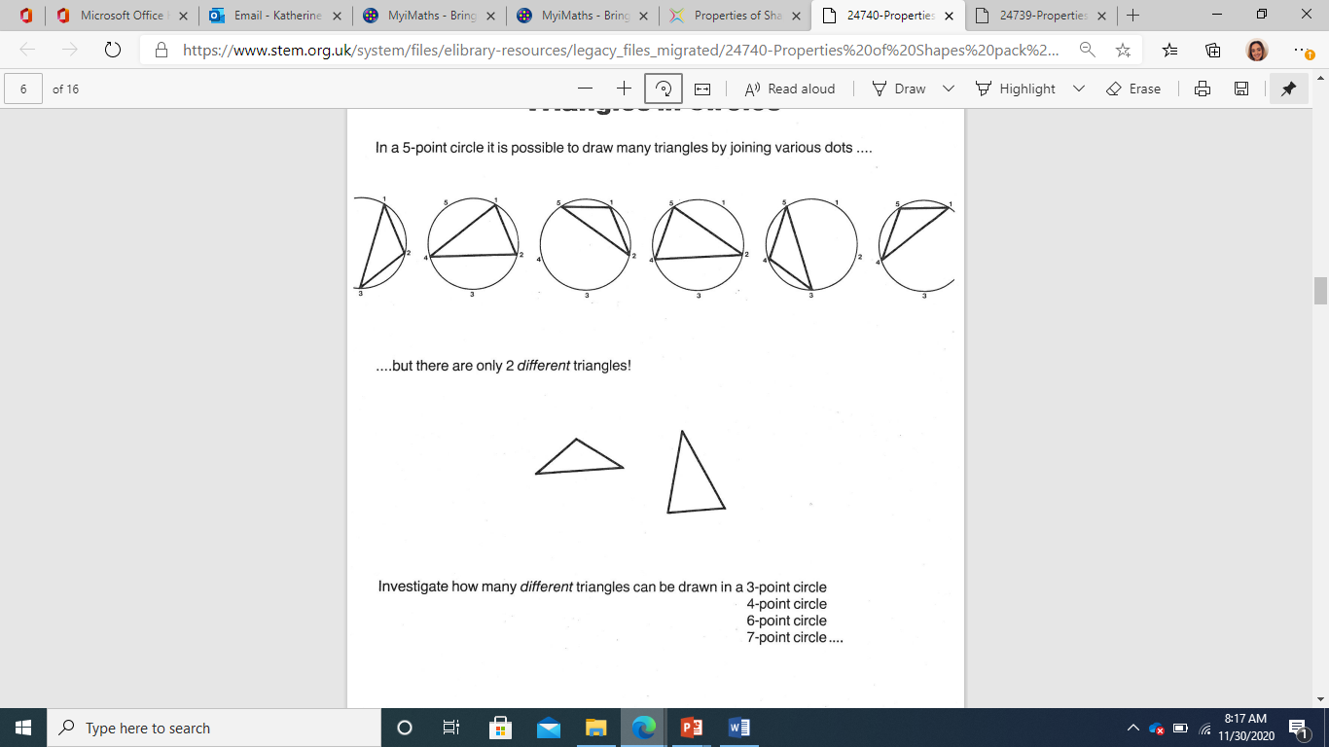
Extension

Slide 29
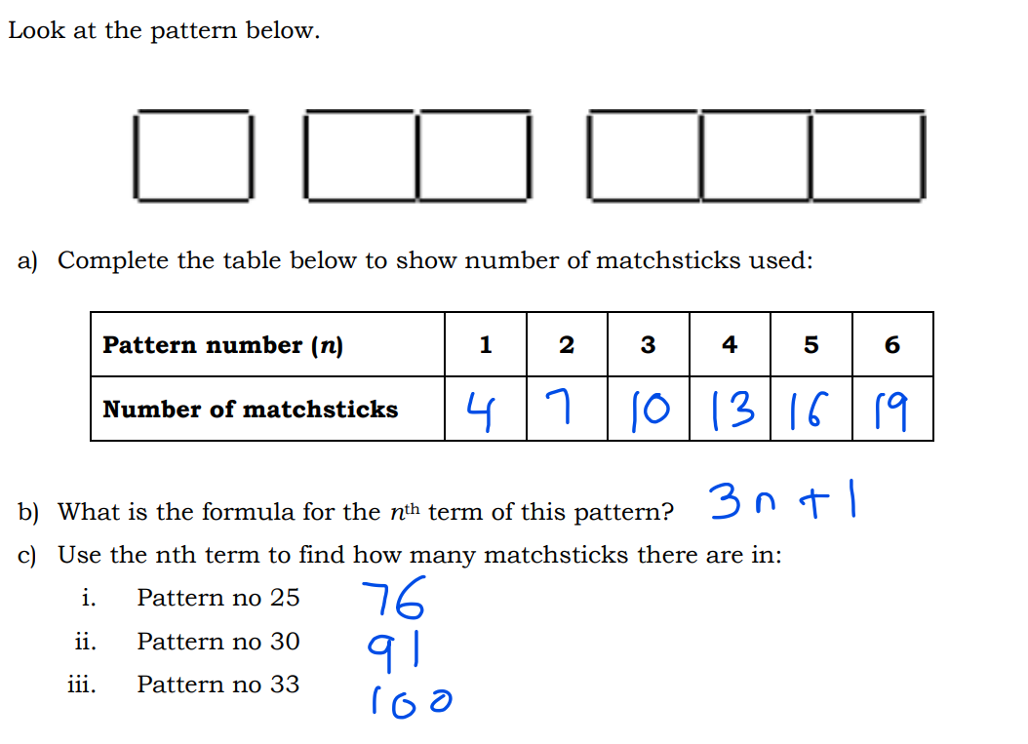
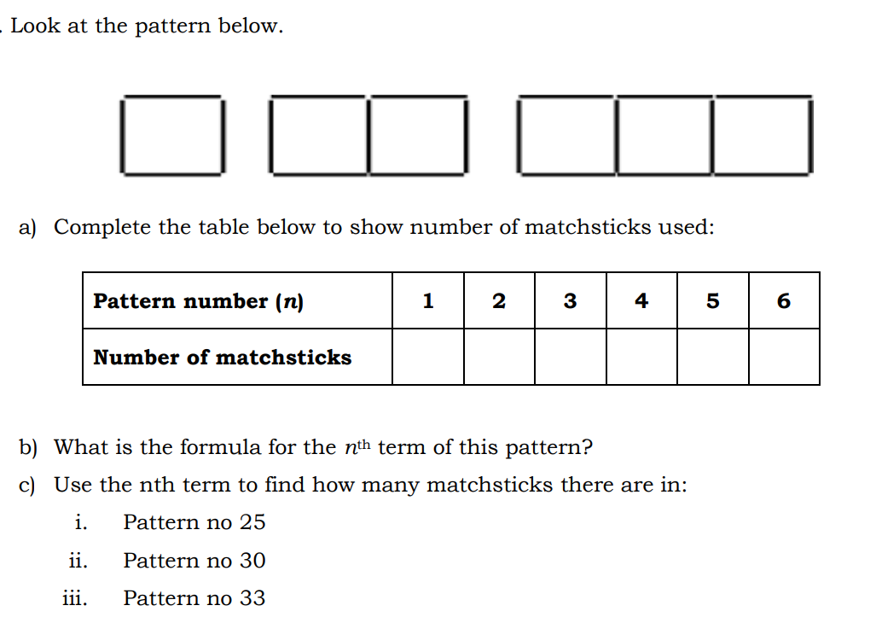

Slide 30
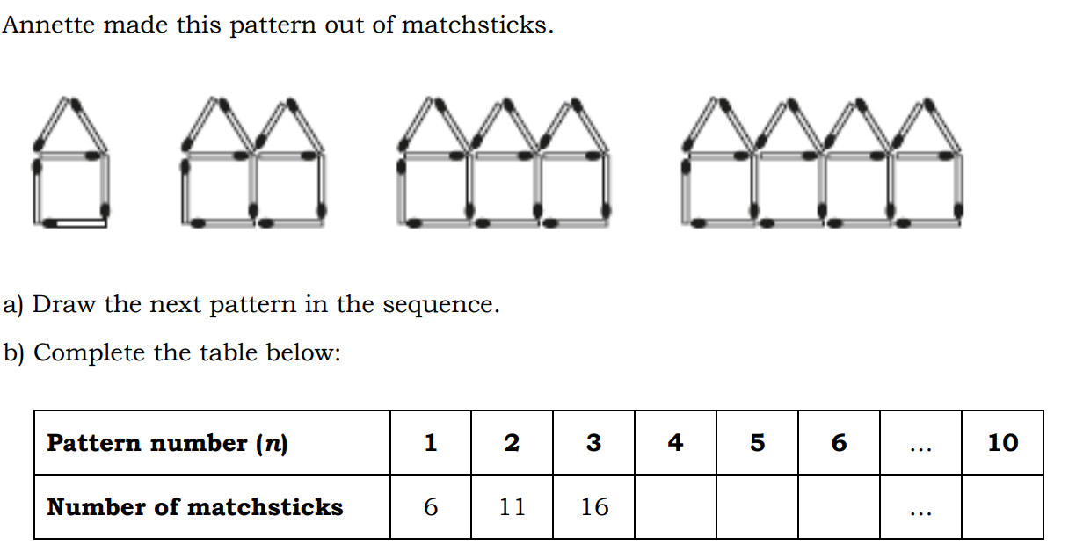

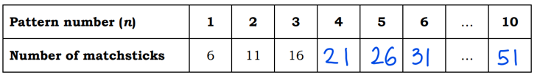

a) Draw the next 3 patterns in the sequence.
c) Write the relationship between pattern number(n) & number of matchsticks?

Slide 31
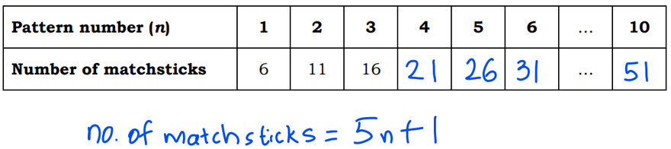
d) Test the relationship between pattern number(n) & number of matchsticks?
Recall Test:
Substitute numbers into your rule that were originally given to you
Check the relationship for n = 1, 2 and 3
For n = 1,
No. of matchsticks = 5(1) + 1
= 6
For n = 2,
No. of matchsticks = 5(2) + 1
= 11
For n = 1, 2 and 3,
The number of matchsticks matches with the given values above. The formula is tested & it works correctly.
For n = 3,
No. of matchsticks = 5(3) + 1
= 16

Slide 32
e) Verify the relationship between pattern number(n) & number of matchsticks?
Recall Verify:
Substitute numbers into your rule that you predicted. (Min-2, Max-3)
Check the relationship for n = 4, 5 and 6
For n = 4,
No. of matchsticks = 5(4) + 1
= 21
For n = 5,
No. of matchsticks = 5(5) + 1
= 26
For n = 4, 5 and 6,
The number of matchsticks matches with the given values above. The formula is verified.
For n = 6,
No. of matchsticks = 5(6) + 1
= 31

